Slide 1

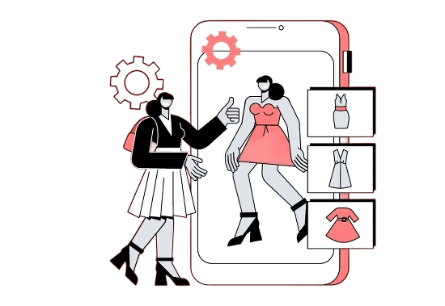


E-PROVA
VIRTUAL TRY ON SYSTEM
Experience e prova like never before, transforming online shopping into a personalized adventure.
SUPERVISUR : AHMED HESHAM
1

Slide 2





Team members :
Marwan shamel 20210895
Marwan abdelrady 20210896
Marwan magdy | 20210898
Mariam samy | 20210913
Mariam fathy | 20210921
Mariam elsayed | 20210908
2

Slide 3





agenda
Problem Statement Solution
system architecture system work flow Challenges
Related Work Experiments implemtation Evalution future work Conclusion
1
2
3
4
5
6
7
8
9
10
11
3

Slide 4

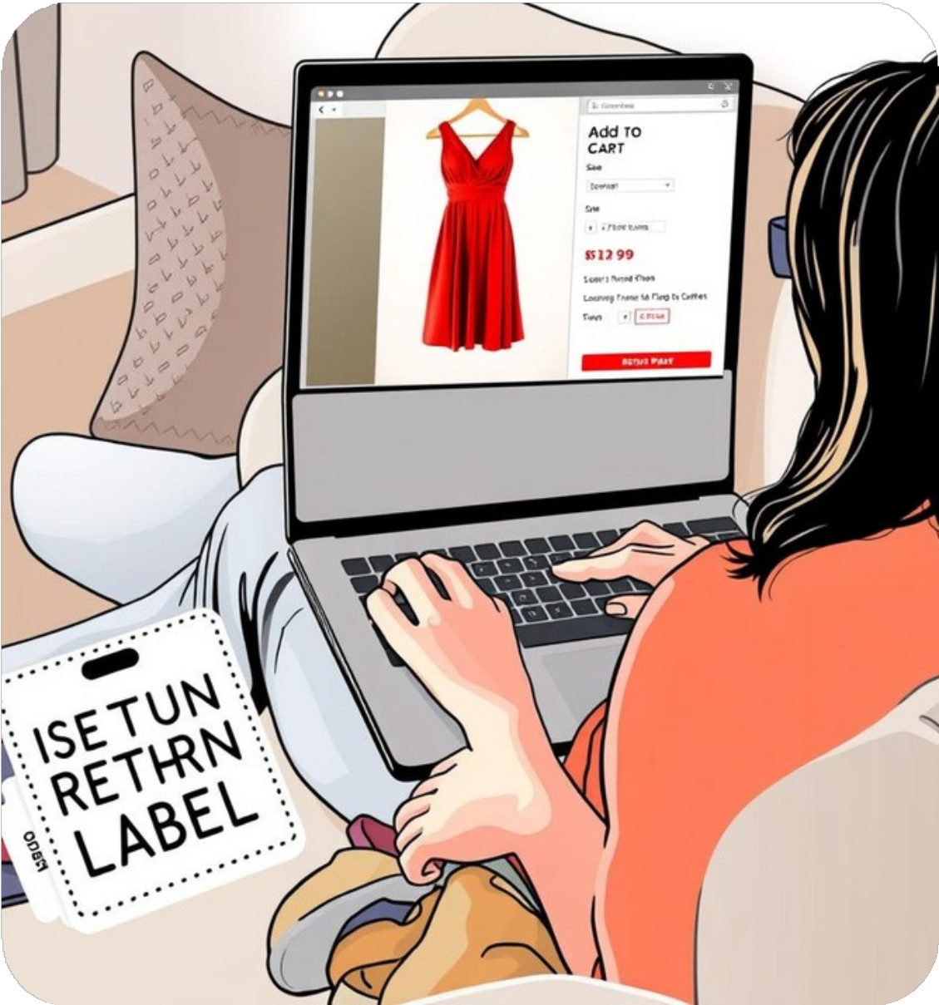

the problem
Online clothes shopping offers convenience and variety, but a key issue remains: users can't try on clothes before buying. This causes uncertainty, poor fit, and high return rates. Many customers hesitate to purchase due to doubts about size and style.
Most platforms lack interactive tools to visualize clothes on real users, relying instead on static images and models. This makes the experience harder for first-time shoppers or those with limited fashion knowledge—especially in areas without access to physical stores.
4

Slide 5


solution
Our solution integrates AI-based virtual try-on into a scalable e- commerce platform, allowing users to confidently explore, visualize, and purchase clothing online through a seamless and engaging experience.
Scalable, User-Centric Platform:
A centralized catalog, user accounts, and tailored recommendations ensure 24/7 access. This seamless setup allows easy integration of features like virtual try-on without disrupting the shopping flow
Enhanced Conversion and Reduced Returns:
Realistic garment previews increase customer confidence and conversion rates, while setting clear expectations helps reduce returns and cut retailer costs.
Personalized, Interactive Experience:
Combining e-commerce with virtual try-on enables users to try styles virtually, get AI-based size suggestions, and receive personalized recommendations
—enhancing satisfaction, loyalty, and overall engagement.
5

Slide 6
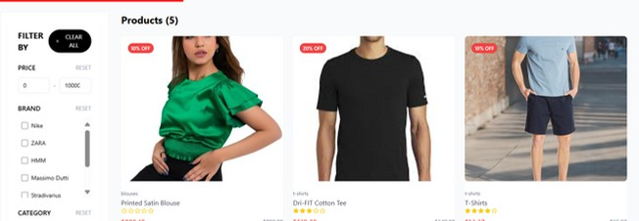

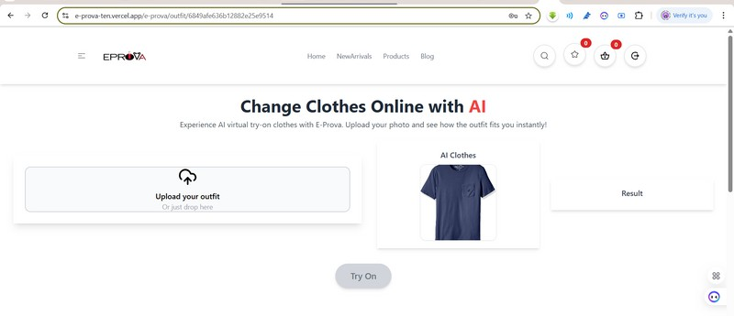
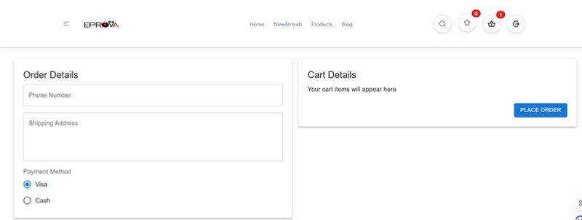


System architecture
1. The Customer Journey
Browsing: User opens the React-based website and explores categories, products, and brands.
Virtual Try-On
Uploads a full-body photo, selects a product → request sent to Flask AI server.
Server returns a preview showing how the product looks on the user.
Checkout
Processes payment, updates inventory, and triggers confirmation emails
Order Confirmation:
Order saved in MongoDB, stock updated, cart cleared
6

Slide 7
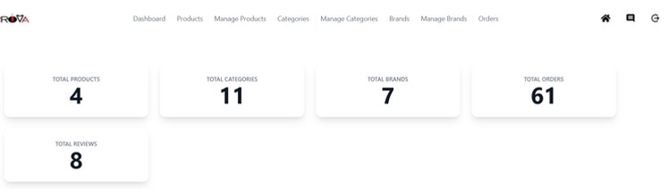

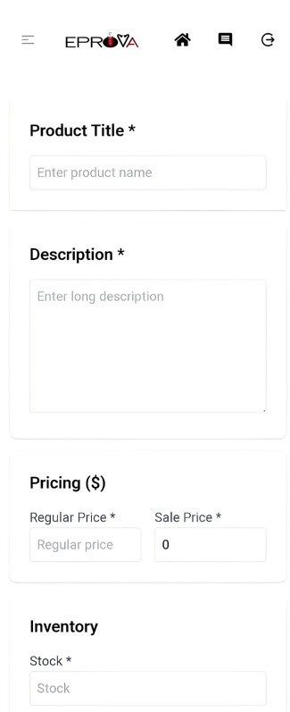
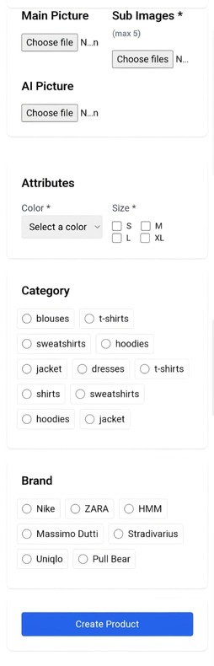



System architecture (cont)
2.Admin Role Journey
Manage Products:Add, update, or remove product listings and images.
Manage Categories & Brands: Organize store structure and update associations.
Track Orders: View customer orders, filter by status, and update.
Review Monitoring: View or delete customer reviews if needed.

Slide 8

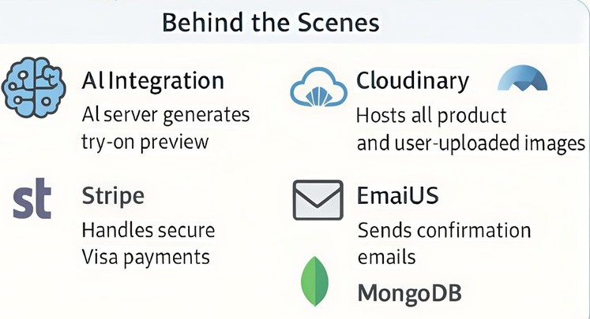
How Does the Magic Happen?
AI Integration: Flask-based backend receives image + product info → returns styled try-on.
Cloudinary: Hosts all product images and uploaded user images.
Stripe: Handles secure Visa payments.
EmailJS / NodeMailer: Sends confirmation and reset emails. MongoDB: Stores all structured data (users, products, orders, etc.)

Slide 9
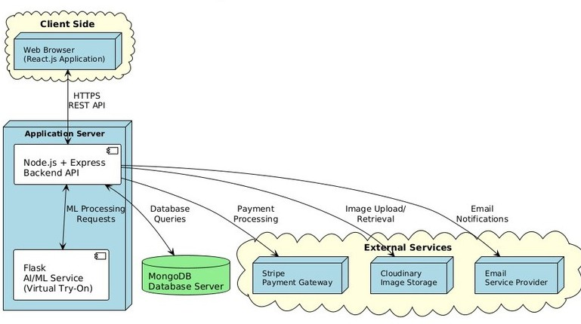
virsual try on workflow
The E-Prova system uses a React.js web client connected to a Node.js + Express backend, which manages user interactions, data flow, and external service integration. A Flask-based AI/ML service handles virtual try-on image processing. MongoDB stores user and product data, while external services like Stripe, Cloudinary, and an email provider handle payments, image storage, and notifications. This architecture supports a smart, scalable, and interactive virtual shopping experience

Slide 10





Challenges
1.Vercel Serverless Limitations
Problem:
Vercel’s serverless functions have timeout limits and experience slow cold starts impact :
Delays in receiving virtual try-on image responses from the AI model Affected user experience during try-on interactions
2. Cloudinary Storage Constraints
Problem:
Cloudinary’s free plan imposes strict limits on storage and image upload size.
impact :
Limited number of product uploads
Required frequent image cleanup and manual monitoring
3. Stripe Business Account Verification
Problem:
Stripe required a verified business account for full payment integration..
impact :
Delayed deployment of the payment feature Slowed down testing and demo readiness
10

Slide 11

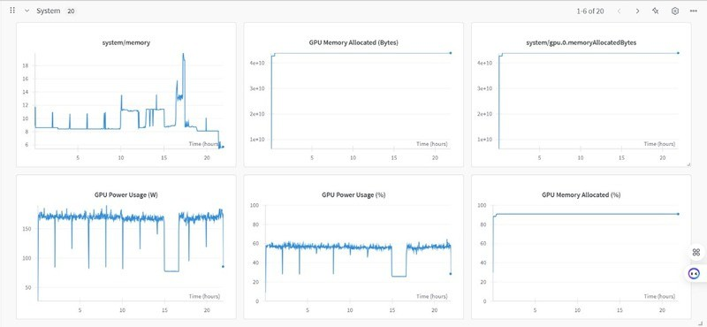
Challenges
Limited Computational Resources
Problem:
Only 4GB GPU memory available (Colab/Kaggle free tier) Required 12GB+ for full IDM-VTON training
Impact:
83% of experimental runs crashed during diffusion refinement 3-4 hour processing times per image on CPU fallback
Prohibitive Cloud Costs
Problem:
Cloud GPUs (A100/V100) cost $2.1-$4.8/hour Full training required 200+ GPU hours
impact :
Budget constraints forced 75% reduction in training iterations
Reliance on pre-trained checkpoints with limited customization
10

Slide 12


Challenges
6. Session Instability
Problem:
Runtime disconnections after 12h (Colab limits) Memory leaks during TPS warping
Impact:
Lost 17 completed experiments due to session crashes Required manual checkpointing every 30 minutes
Mitigation Strategies
Adopted mixed-precision (FP16) training → 40% memory reduction
Implemented gradient checkpointing → Enabled larger batch sizes
Used Hugging Face cached models → Avoided redundant downloads
10

Slide 13





Related Work
1-Image-Based Virtual Try-On using GANs:
Deform (warp) the garment to fit the person's body shape.
Use GANs to generate the final image.
Limitation: Poor generalization to complex backgrounds and diverse poses.
2-Diffusion-Based Virtual Try- On:
Apply diffusion models like TryOnDiffusion with dual UNet architecture.
Some methods treat the task as image inpainting using reference images. Limitation: Difficulty in
preserving fine garment details.
13

Slide 14



Related Work (cont.)
3-Conditional Control in Diffusion Models:
Enhance generation by adding controls like pose, edges, depth.
Models like ControlNet and IP- Adapter allow more accurate generation using both text and image prompts.
4-Customization of Diffusion Models:
Fine-tune models using a few personal images (few-shot learning).
Achieve better adaptation to real-world data without catastrophic forgetting.
Also useful for tasks like image
completion or restoration.
14

Slide 15

Experiment 1: Lady VITON
Goal : Test a baseline virtual try-on system
Setup: Used Lady VITON repo with VITON-HD dataset
Preprocessing: No automatic preprocessing – required manual alignment
Results: Output lacked realism and consistencyand and Clothes were poorly aligned with user body.
15

Slide 16
Experiment 2: IDM-VTON
Goal : Improve realism and automate the pipeline
Setup: Used IDM-VTON with the same dataset
Preprocessing:Better fit and more realistic overlay,Handled occlusions and body shapes smoothly
Results: Better fit and more realistic overlay and Handled occlusions and body shapes smoothly.

Slide 17
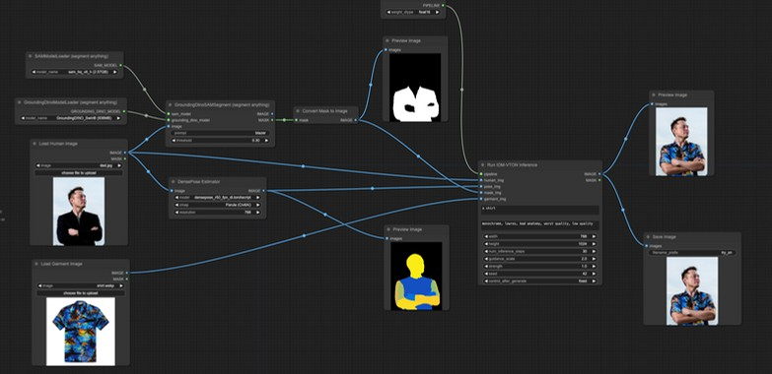

implementation flow
[1] Start

Slide 18


implementation flow (cont)
Load Human Image
The first thing you do is upload an image of the person (the person you will try the clothing on)
Load Garment Image
Then you upload an image of the clothing you want to try on (the shirt or blouse, for example)
Segment the Garment (Cloth Mask Generation)
Using:GroundingDINO + SAM (Segment Anything)
The clothing in the image is automatically identified based on a prompt word like "blazer."
SAM creates a mask to define the boundaries of the clothing.
This mask is converted to a black and white image (binary mask).
18

Slide 19

implementation flow (cont)
Get Human PoseUsing:
DensePose Estimator
This extracts the body shape and distribution of parts (head, arms, body) as a pose
image.This image helps in adjusting the clothing to fit the person's body
Run IDM-VTON InferenceIt
takes as inputs :human_img → the person's image garment_img → the clothing image
mask_img → the mask that defines the clothing pose_img → the image showing body distribution
garment_des → a simple description of the clothing (like "a shirt") the output:A new image of the person as if they are wearing the clothing
you selected.

Slide 20
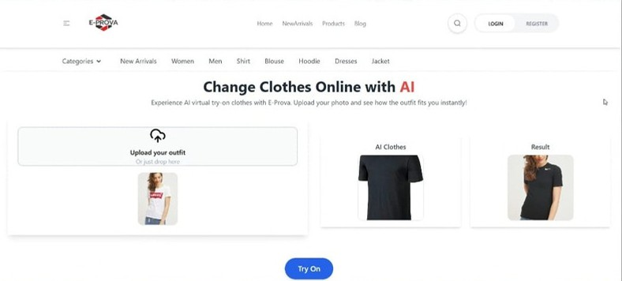
implementation flow (cont)
6. Output + Save ImageIt displays the output as a new image that you can save.

Slide 21

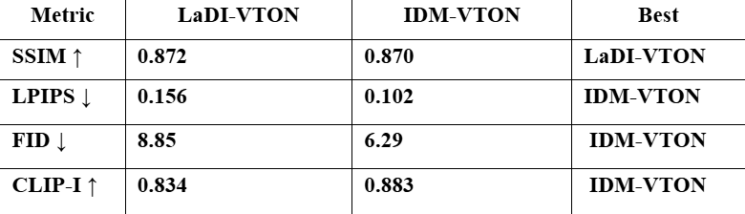
Evaluation
this is like a comparison between ladi and IDM in :
SSIM (Structural Similarity Index):
Measures image similarity
LPIPS (Learned Perceptual Image Patch Similarity): A perceptual metric where lower is better
FID (Fréchet Inception Distance): Lower FID indicates better alignment with real distribution
CLIP-I (CLIP Similarity Score): Evaluates how well the generated image matches the textual description (or reference image) using CLIP embeddings

Slide 22

Why Better?
Automatic Preprocessing:
handles preprocessing steps (like pose estimation and parsing) automatically
Better Garment Fit:
aligns clothes more accurately on the body, especially with complex poses.
More Realistic Results:
The output images are more natural and preserve garment details better.
Stronger Performance:
works better with complex backgrounds and diverse user poses.
Easier Integration:
IDM-VTON is modular and easier to use in a complete system.

Slide 23
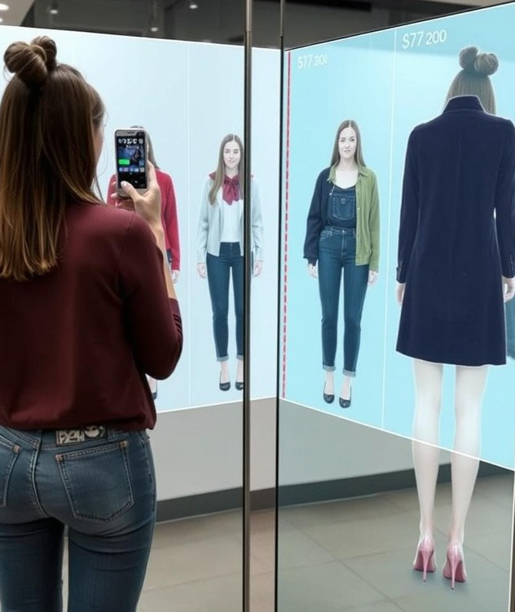

Future work :
Add 3D body modeling for more accurate and multi-angle try-on.
Enable real-time try-on using webcam and AR.
Implement AI-based size recommendations.
Use user feedback to refine model accuracy.
Develop a mobile app for better accessibility.

Slide 24

Conclusion
Our system presents a smart, user-centric solution that transforms the online fashion shopping experience. By integrating AI-powered Virtual Try-On technology into a scalable e-commerce platform, we bridge the gap between physical and digital retail. Customers can now visualize garments on their own image before purchasing, which enhances confidence, reduces returns, and increases satisfaction. This fusion of innovation and convenience not only improves user engagement but also offers businesses a competitive edge in the fast-growing
digital market.
24

Slide 25
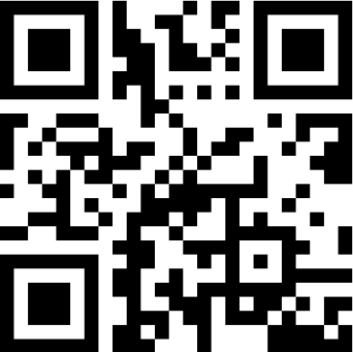
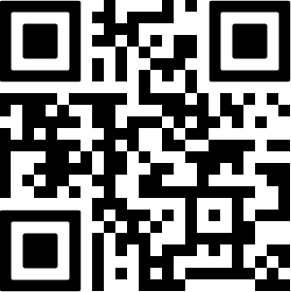
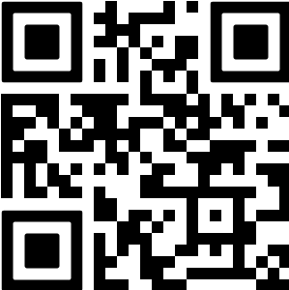
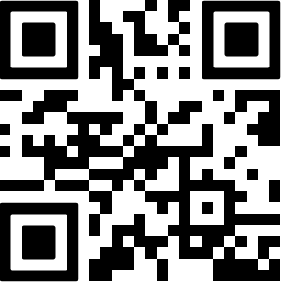
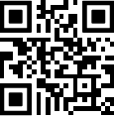
Notebook IDM
Frontend repo
E-PROVA
Notebook LADI
Backend repo
25

Slide 26

Thank You !☺
26

